Slide 1

PV Site Council
September 29th, 2022

Slide 2
Norms & Celebrations
Be Present & Positive
Be Professional
Be Prepared
Be Solutions Oriented
Have Fun!

Slide 3
Community Engagement Opportunities
Kiwanis's Walk-A-Thon: October 1st
Lover Our School Day: October 22nd
Trunk or Treat: October 27th New Date
PV Panther Night: November 9th
**Various Sporting & Music Events**
Outreach Specialist – Erica Gonzalez

Slide 4
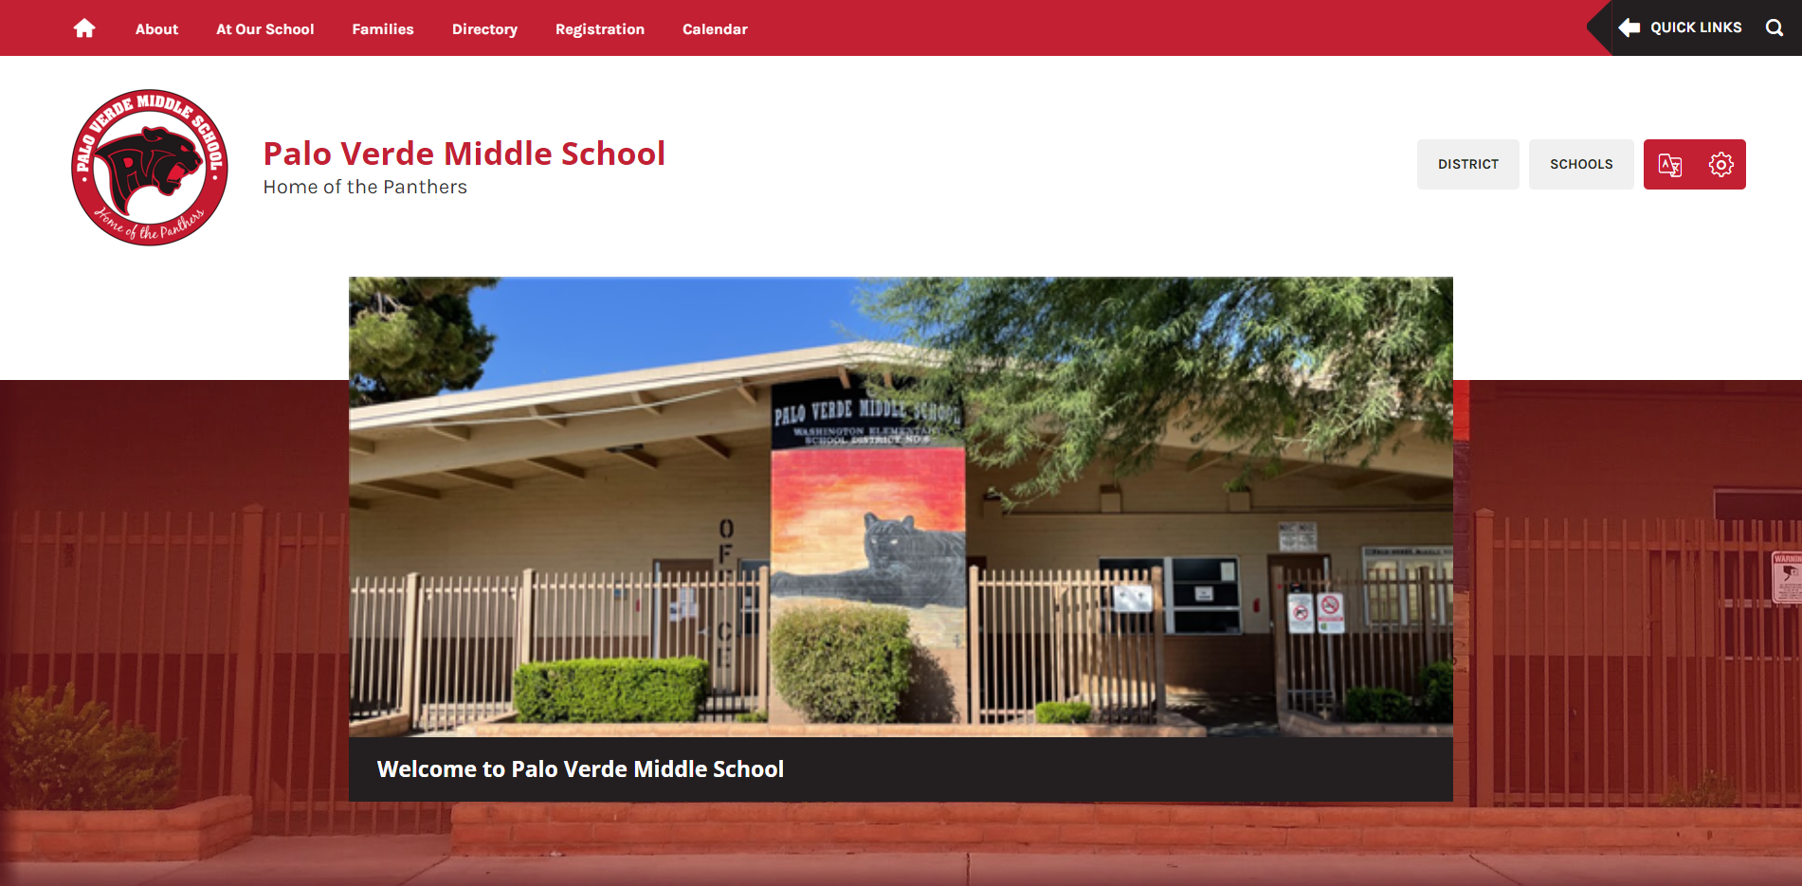
School Website
Updates – Coming Soon!
Principal Message
Bell Schedule
Uniforms
School Budget
Palo Verde ASA Webpage
Social Worker – Biography
PTO Information
Staff Directory

Slide 5
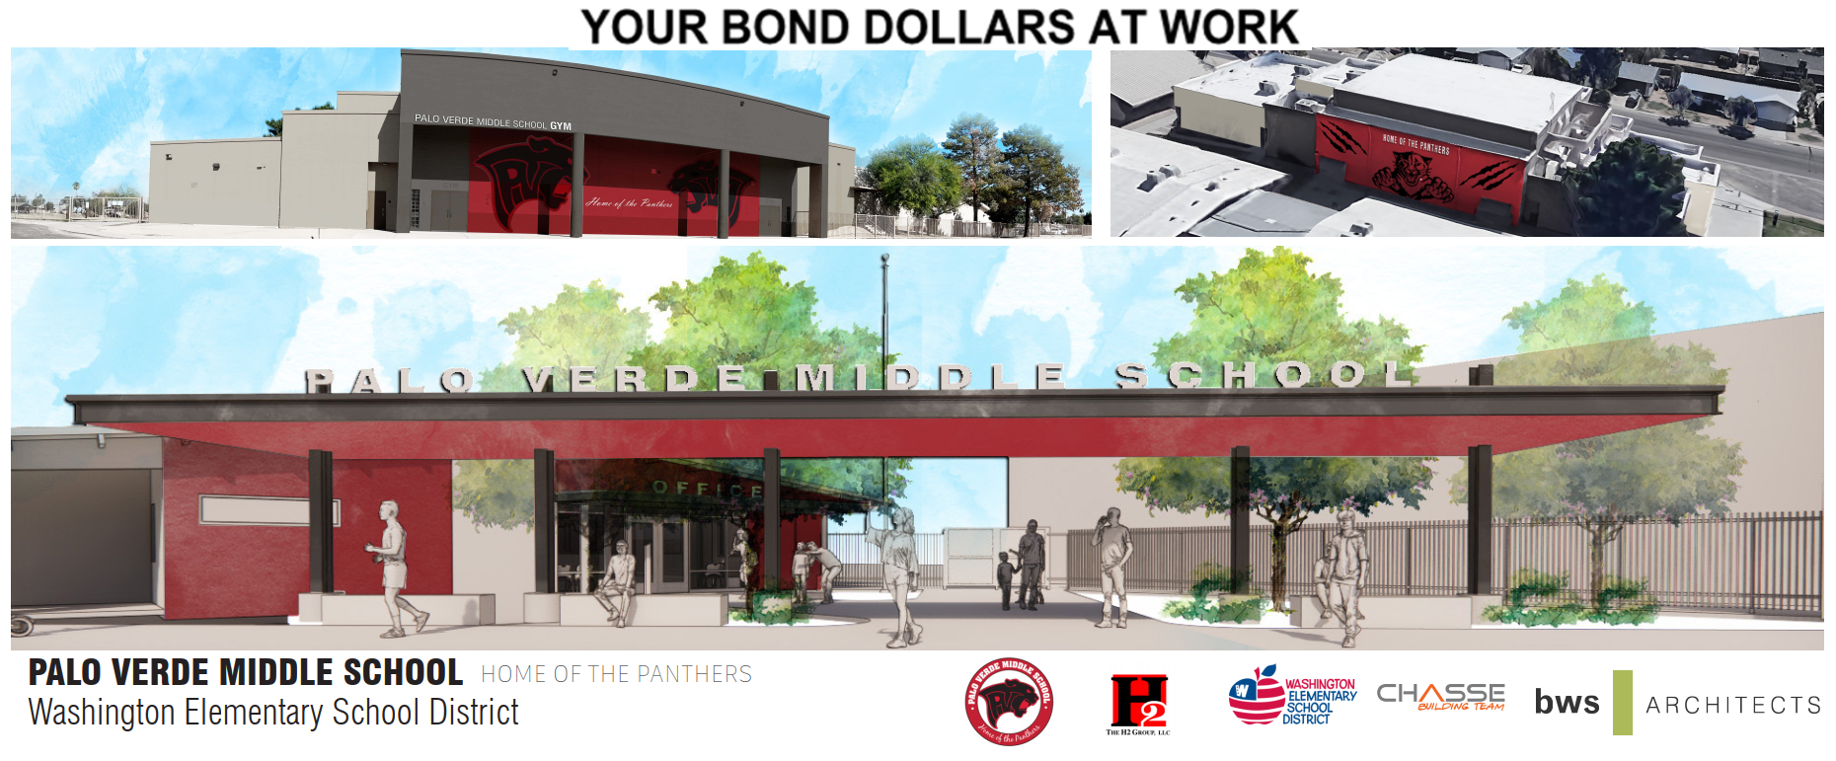
Construction Updates

Slide 6
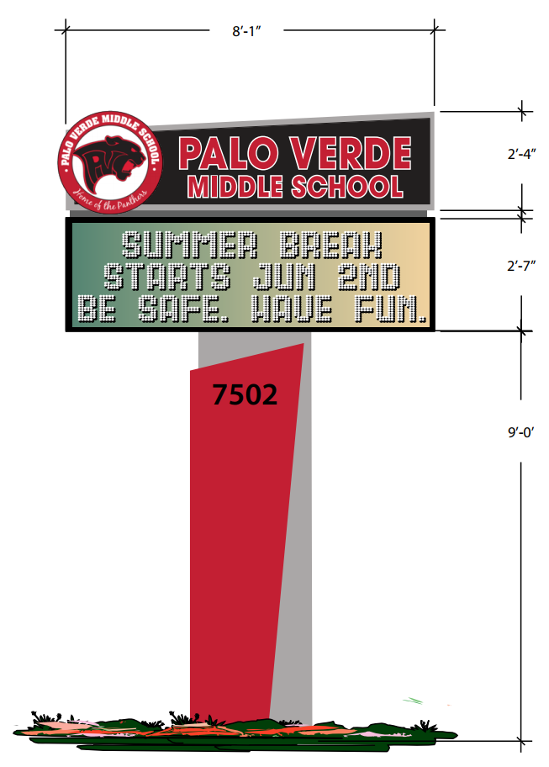
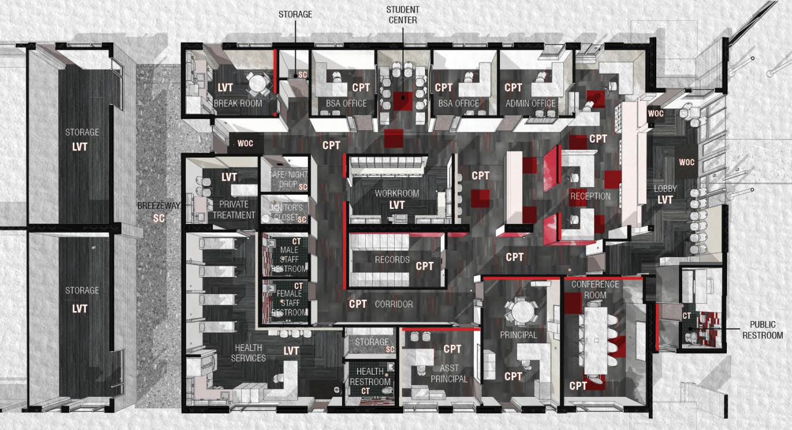
Construction Updates

Slide 7
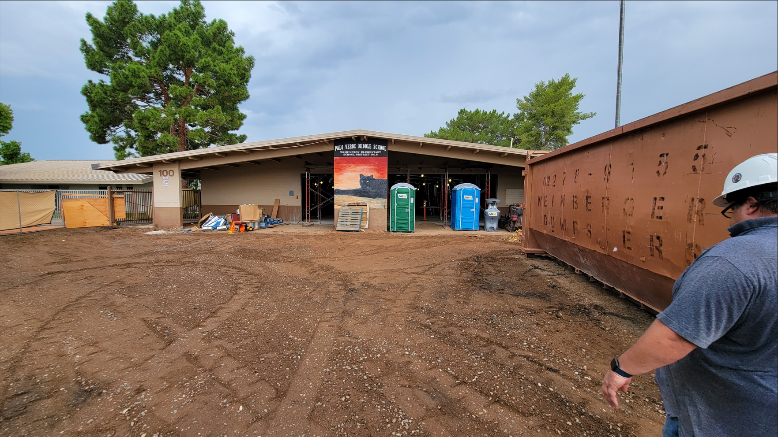
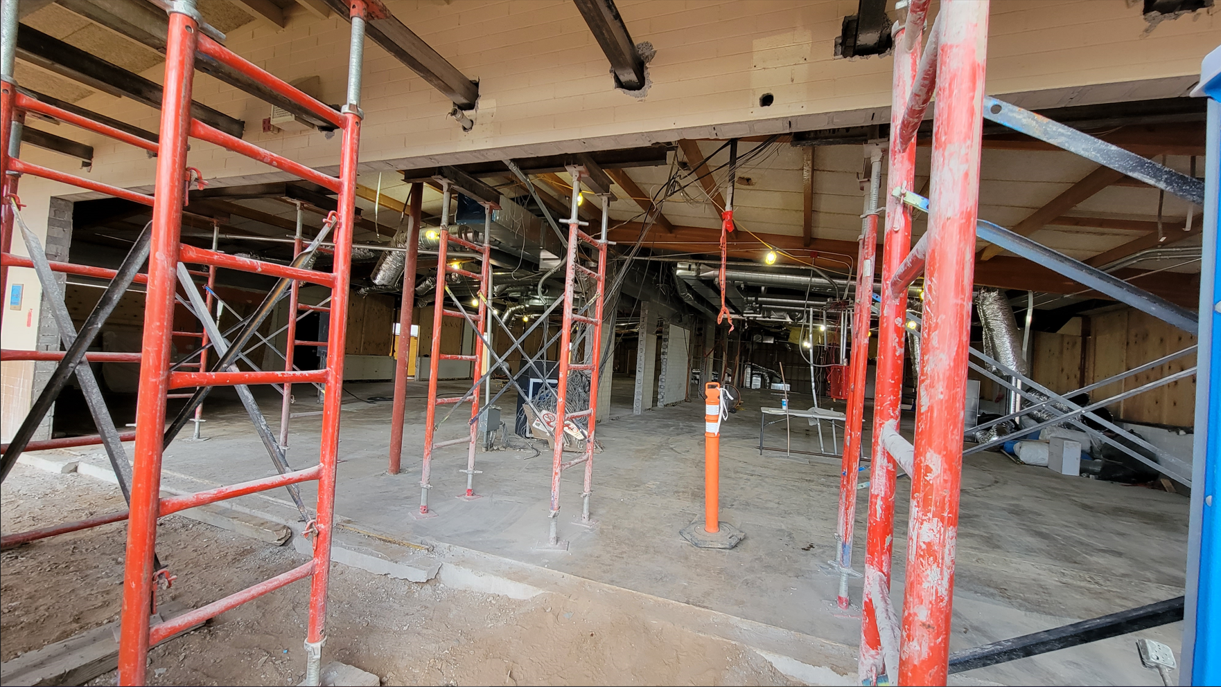
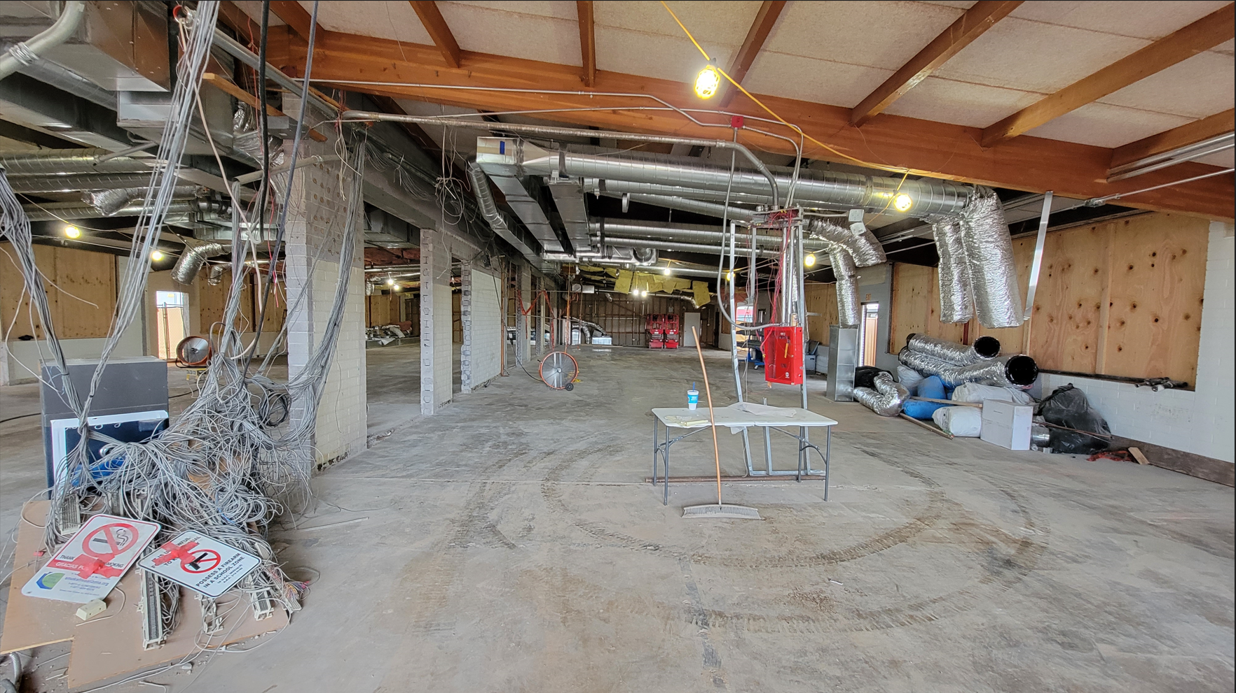
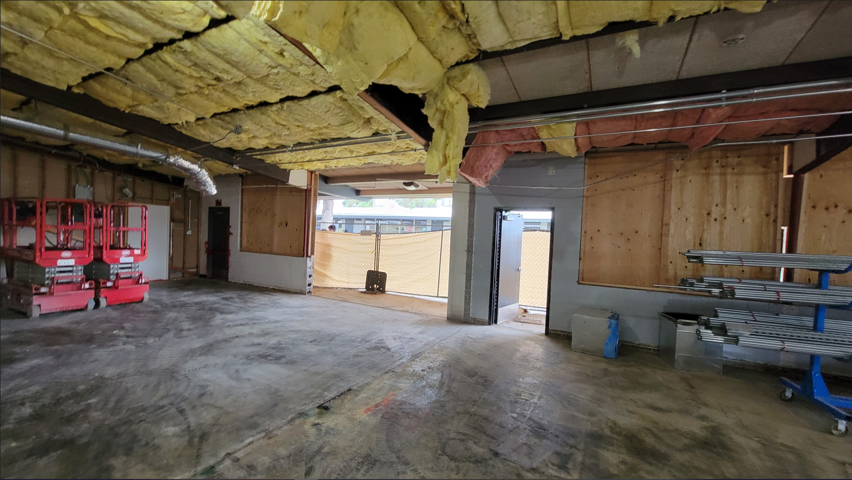
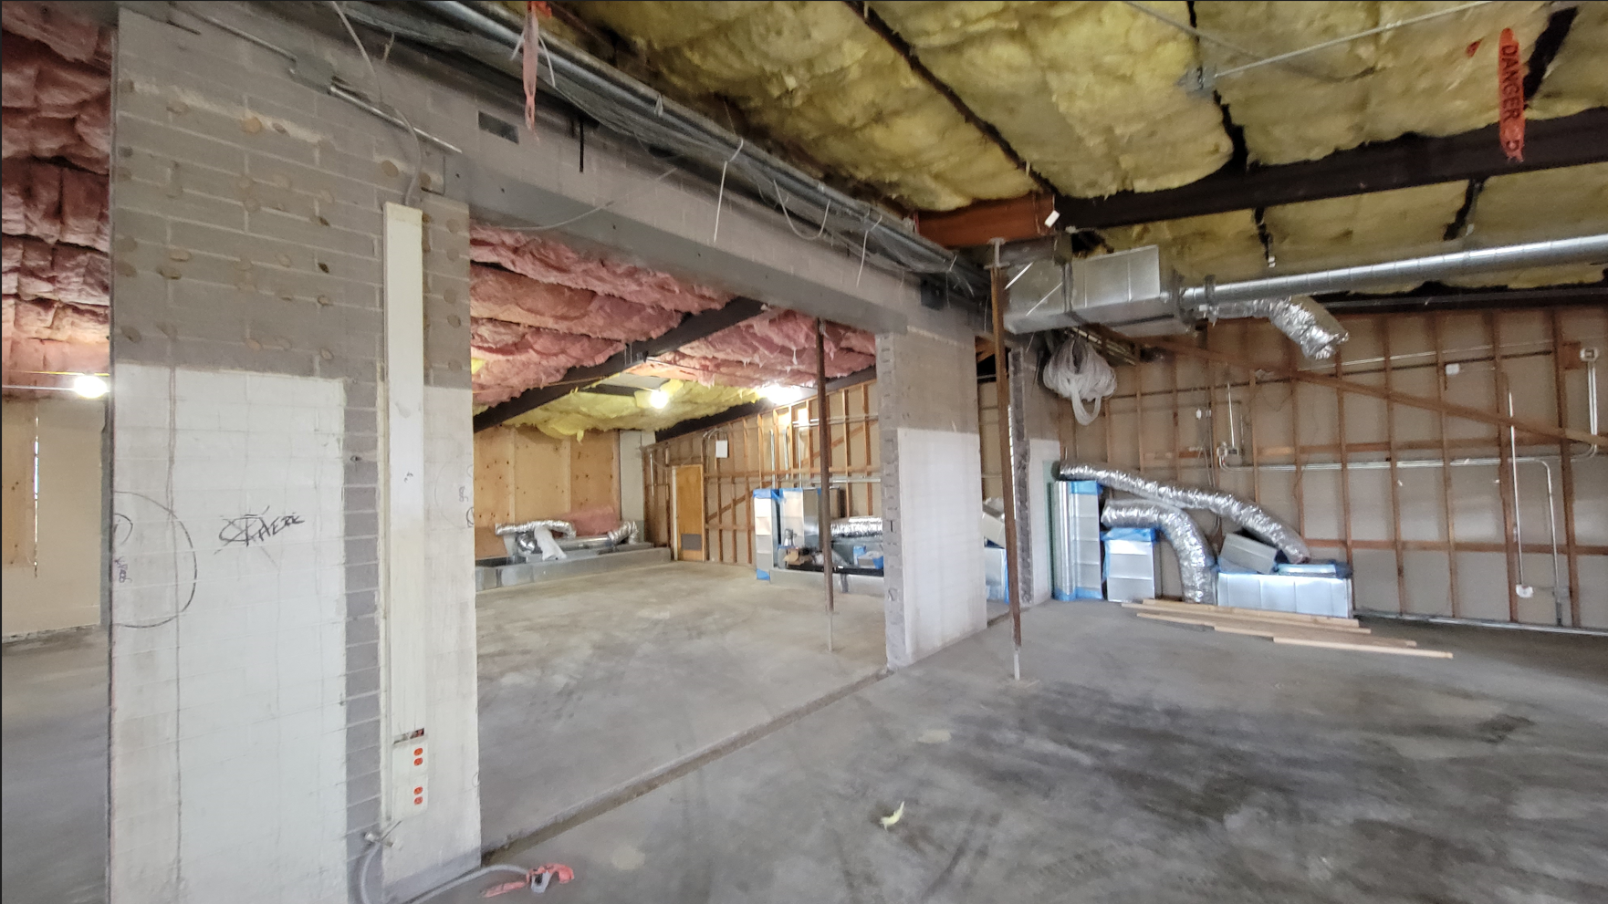
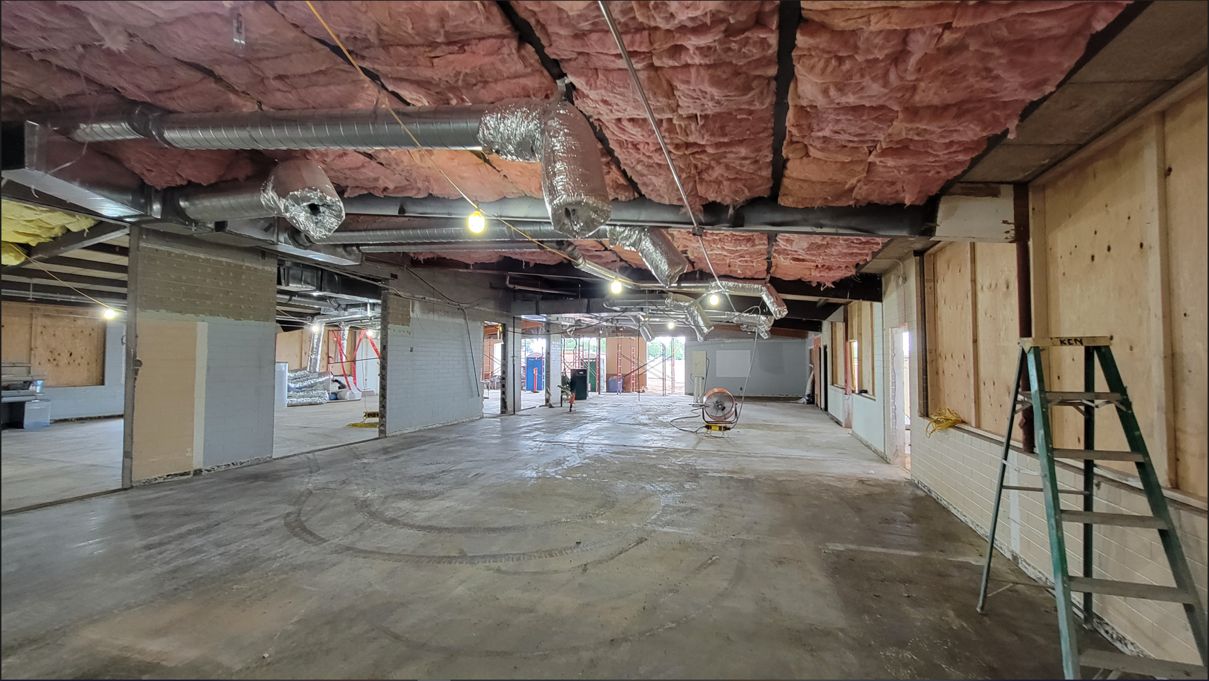
Construction Updates

Slide 8
Construction Updates
Potentially a walk-through during your next Site Council meeting
October 27th

Slide 9
Tax Credit Money
150 – Field Trips: $1,882.85
151 – After School Classes: $4,025.16
153 – Band: $2,739.99
154 – After School Sports: $913.71
155 – Character Education: $1,800.00
159 – Undesignated: $9,482.41

Slide 10

Undesignated Tax Credit
Band Field Trip - California
Field Trip Quotes
Total Cost: $52.020.00
Transportation Cost: $14,724.00
Auxiliary + Tax Credit: $10,704.53
Proposal to move $4,019.47
from 159 to 153
Cost Savings:
$122.70 per student
New Family Contribution Cost:
$310.80

Slide 11
School Safety & Prevention Team
Crisis Plan
SEL Curriculum & Implementation
Behavioral Data
Risk Index

Slide 12
8th Grade Promotion
Requirements – Input needed!
Promotion to 8th Grade
  What are the expectations to move on to 9th grade
Requirements to participate in promotion activities
  i.e.: School Dance, Castles&Coasters, Student vs. Staff Bball Game, Dodgeball Tournament
Requirements to walk in Promotion Ceremony
  Potential Letter to Families: GenEd & SpEd

Slide 13

Community input
& topics for next meeting

Slide 14

Meeting Dates
10/27
11/17
12/15
1/26 4:15pm
2/23
3/30
4/27
5/18

