Slide 1

PV Site Council
August 25, 2022

Slide 2
Norms & Celebrations
Be Present & Positive
Be Professional
Be Prepared
Be Solutions Oriented
Have Fun!

Slide 3
Tax Credit Money
150 – Field Trips: $2122.85
151 – After School Classes: $4025.16
154 – After School Sports: $1854.75
155 – Character Education: $1800.00
159 – Undesignated: $11282.41

Slide 4
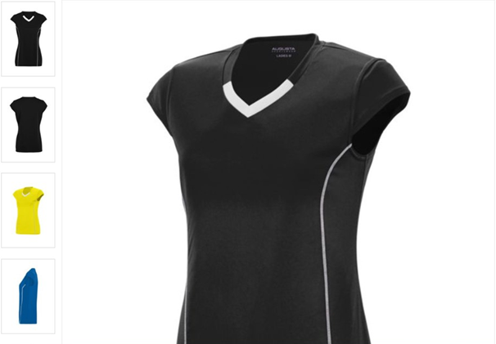
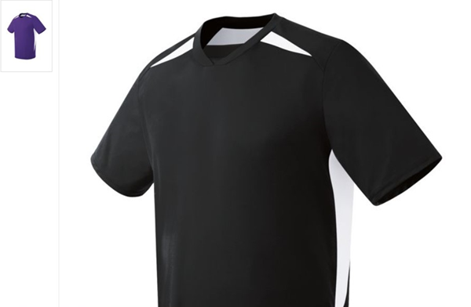
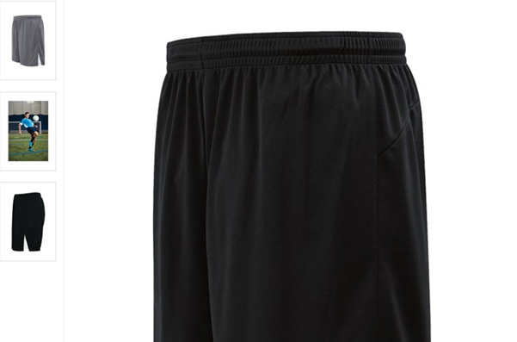
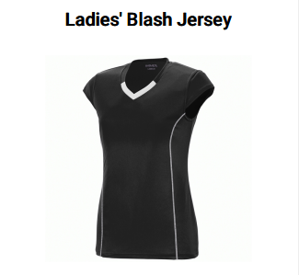
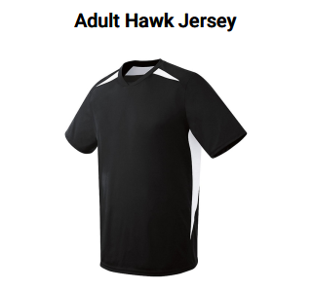

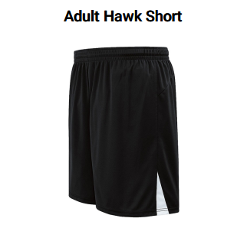
Undesignated Tax Credit
Volleyball Uniforms
Quote 1
M&J Trophies
$2195.57
Quote 2
HP2 Products & Promotions
$1737.75

Slide 5
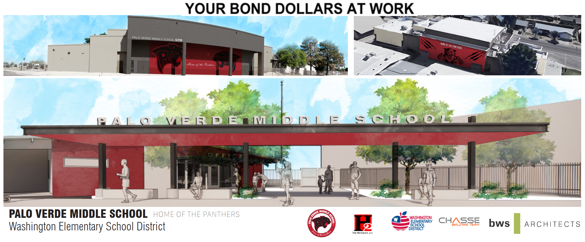
Construction Updates

Slide 6
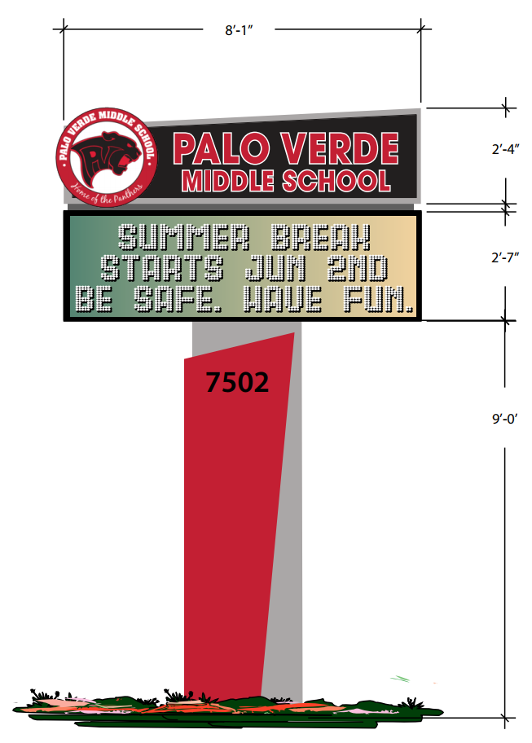
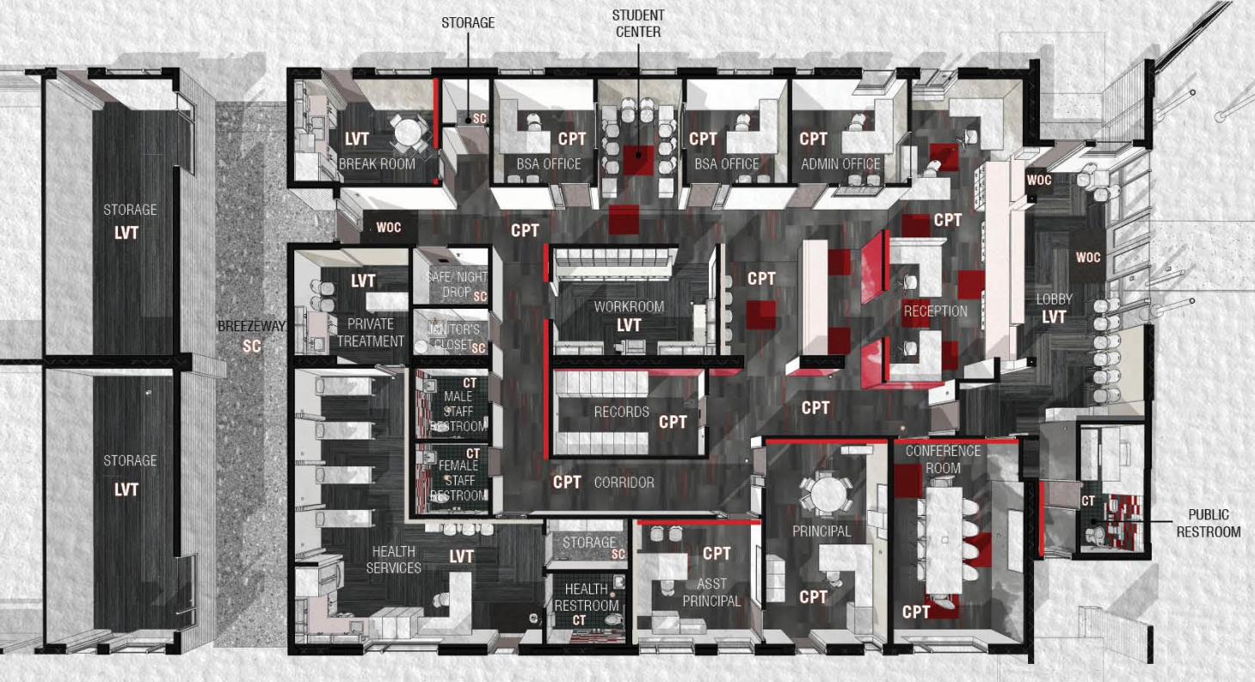
Construction Updates

Slide 7
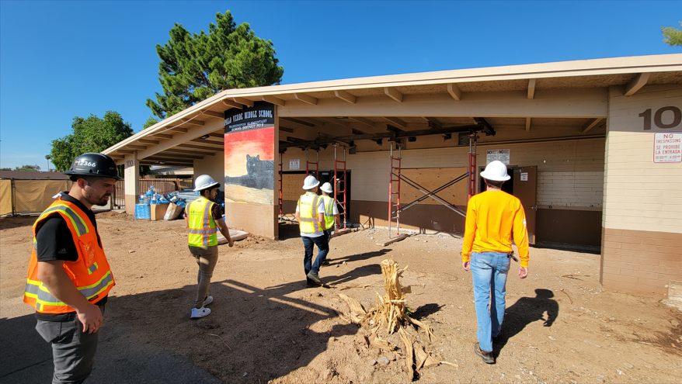
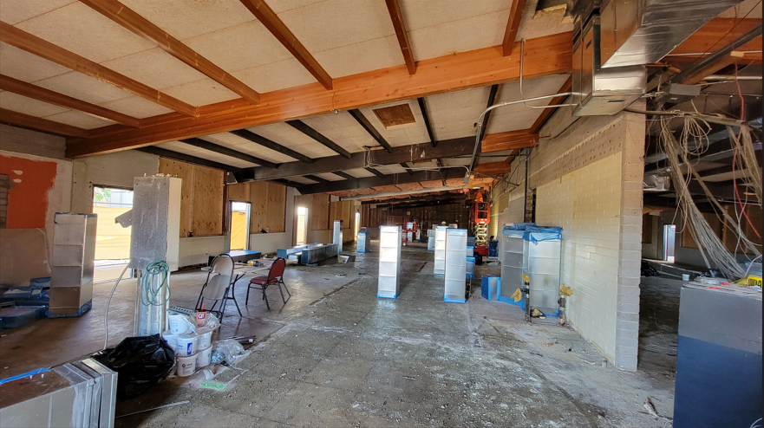
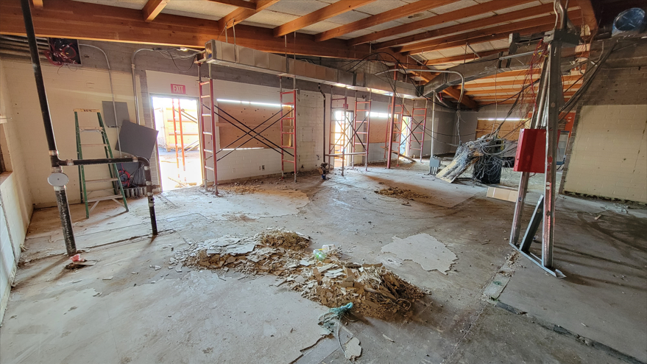
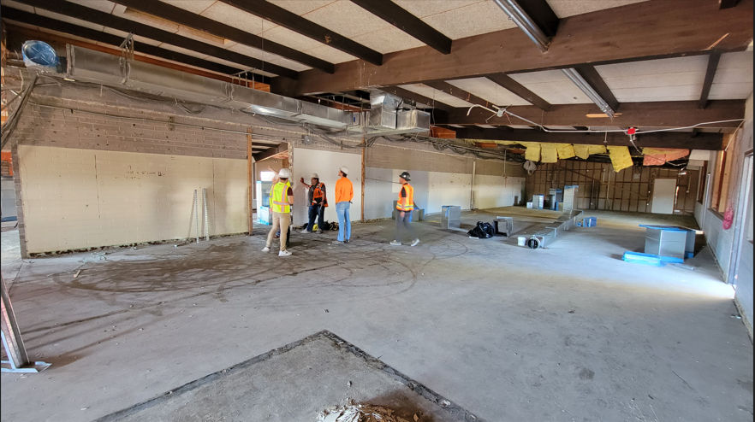
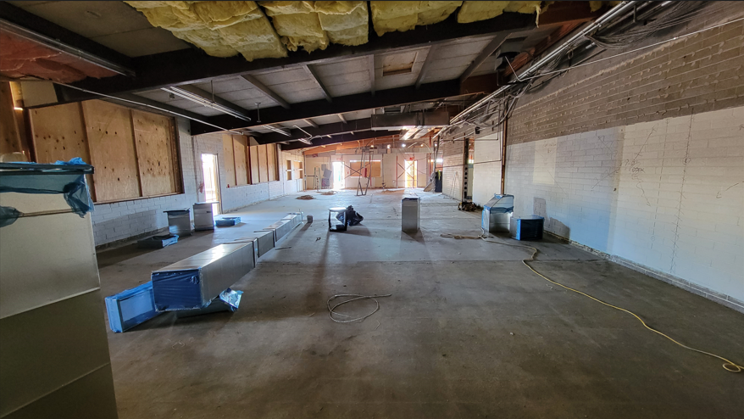
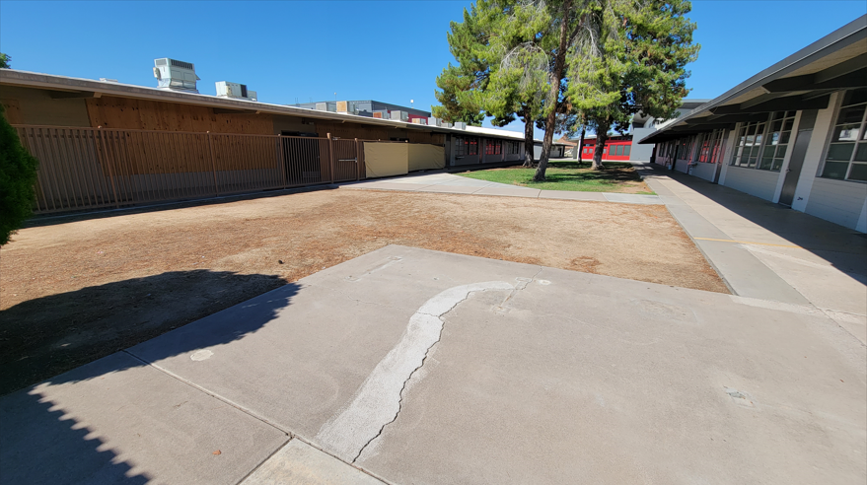
Construction Updates

Slide 8
Continuous
Improvement Plan
Principle 6.1
Our school creates and maintains positive collaborative partnerships among families, communities, and school to support student learning.
Present Goal
Palo Verde will work to increase effective and consistent 2-way communication and partnerships with key stakeholders, with appropriate resources, to support student learning through advocacy and shared responsibility of decision making.

Slide 9
Continuous
Improvement Plan
Present Goal
Palo Verde will work to increase effective and consistent 2-way communication and partnerships with key stakeholders, with appropriate resources, to support student learning through advocacy and shared responsibility of decision making.

Slide 10
Continuous
Improvement Plan
Proposed Updated Goal – 6.1
Palo Verde will work to increase effective and consistent 2-way communication and partnerships with key stakeholders, with appropriate resources, to support student learning, and increase representation of our underrepresented communities through advocacy and shared responsibility of decision making.

Slide 11
Community Engagement Opportunities
Kiwanis's Walk-A-Thon: October 1st
Lover Our School Day: October 22nd
Trunk or Treat: October 28th
PV Panther Pride Night: November 9th
**Various Sporting & Music Events**
Outreach Specialist – Erica Gonzalez

Slide 12
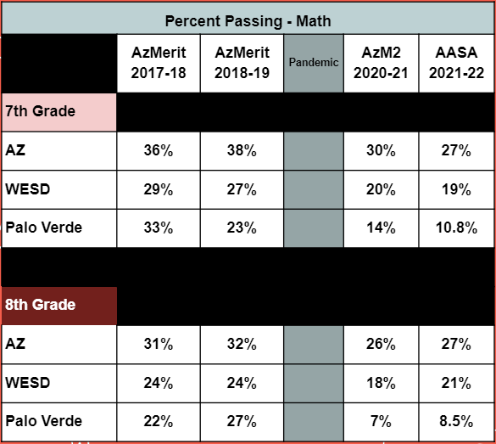

Data Conversation

Slide 13
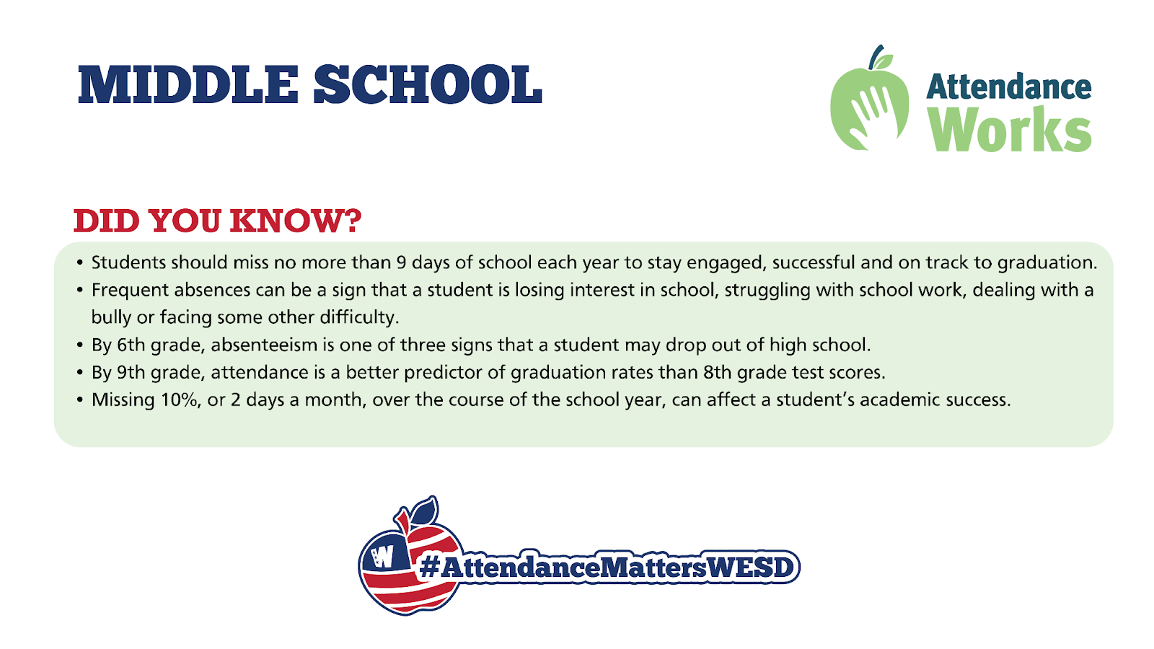
Data Conversation
PV Attendance
2019-20: 94.1%
2020-21: 89.6%
2021-22: 86.7%

Slide 14
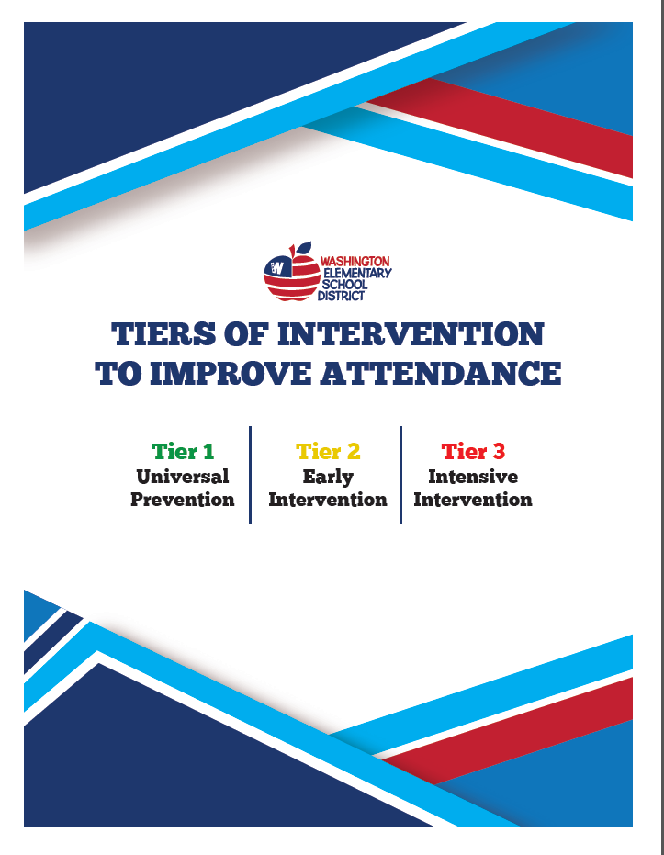
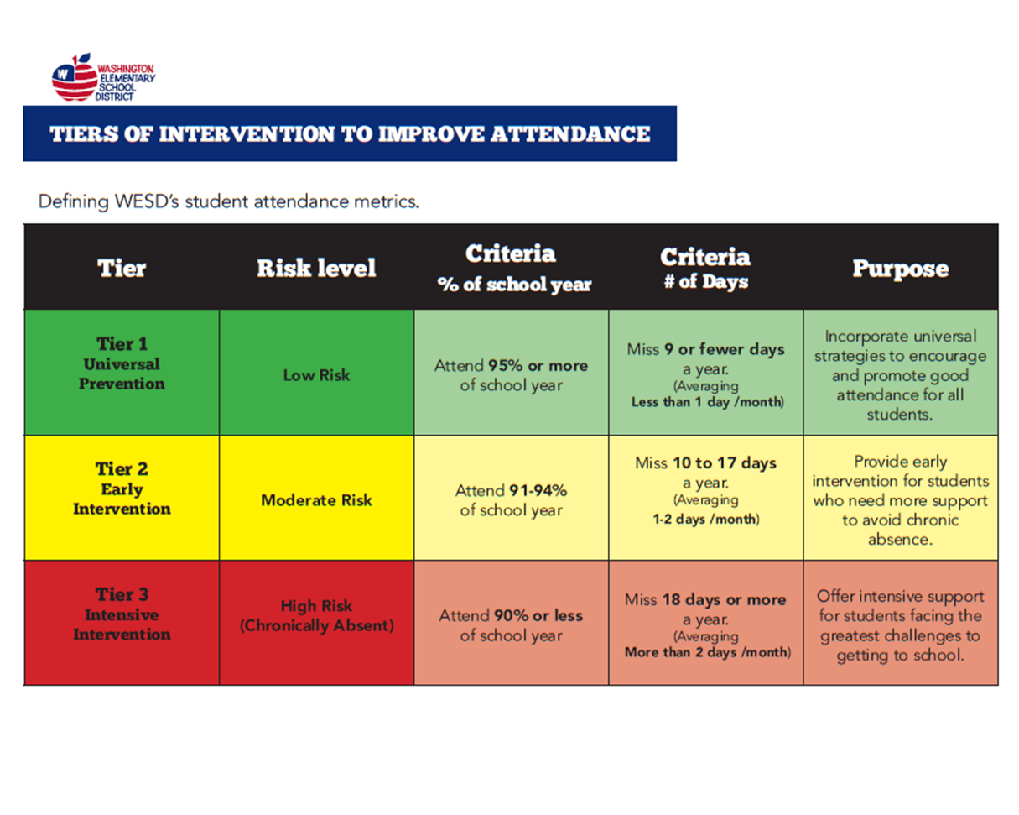
Data Conversation
PV Attendance
2019-20: 94.1%
2020-21: 89.6%
2021-22: 86.7%

Slide 15


Meeting Dates
9/29
10/27
11/17
12/15
1/26 4:15pm
2/23
3/30
4/27
5/18

Slide 16
Community input
& topics for next meeting

