Slide 1
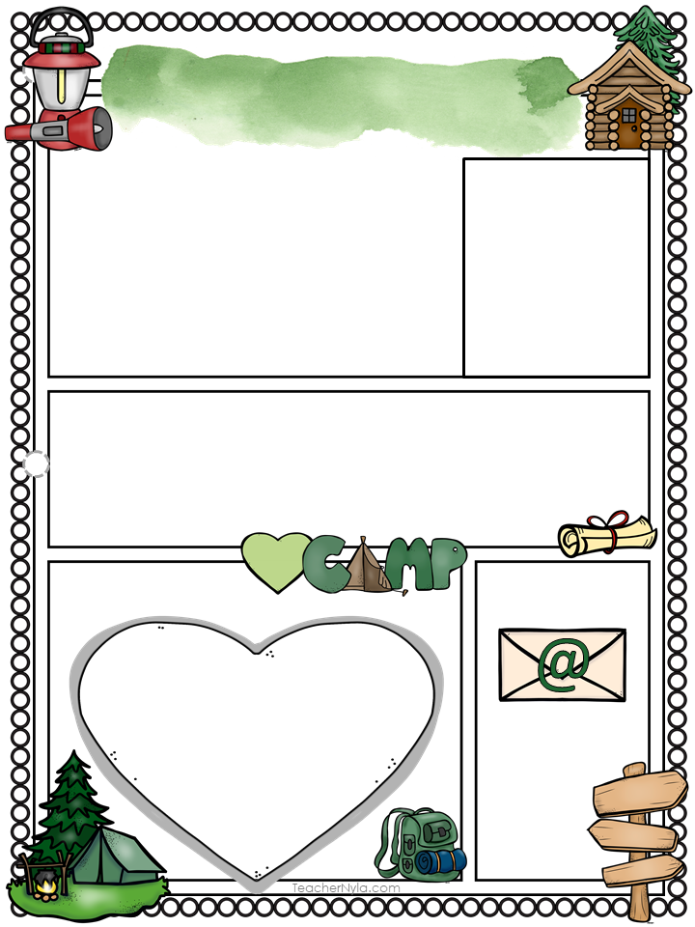
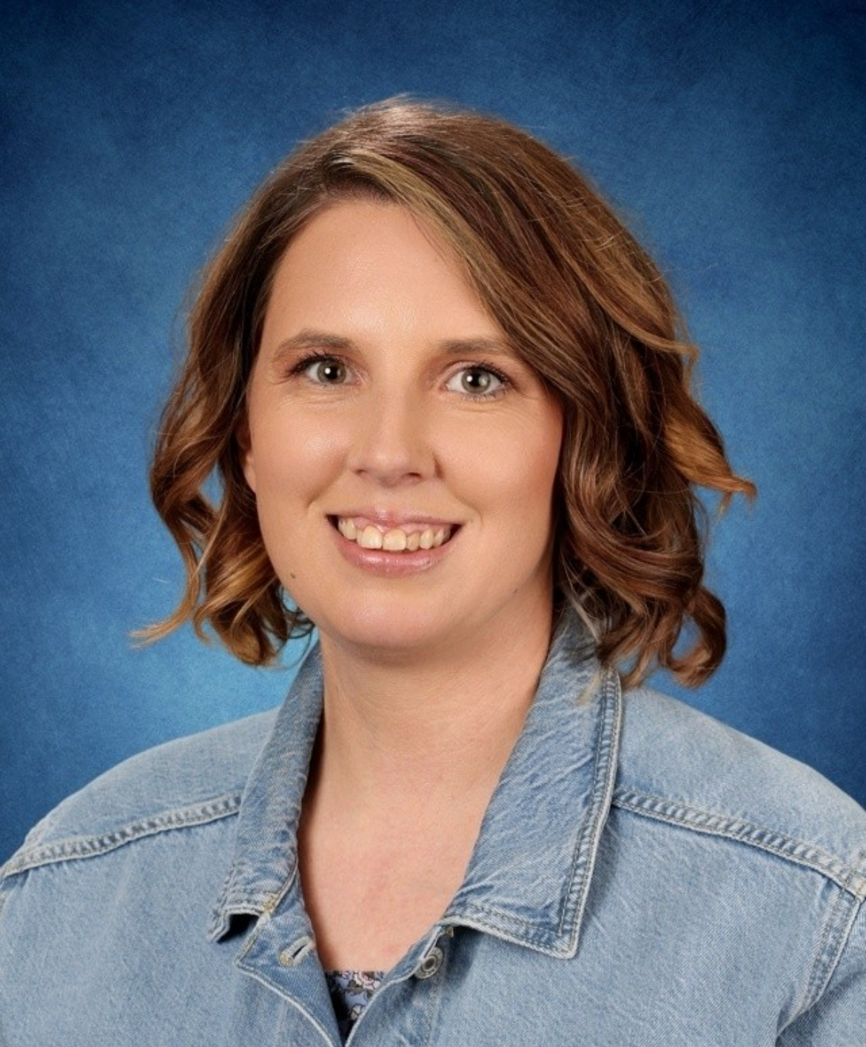

Mrs. Welch
About Me
Hello! I’m Erica Welch, and this is my fourth year teaching at Sahuaro. I’m a wife and a mom to three wonderful kids, One of whom is a fellow Sahuaro student. I am deeply passionate about reading and dedicated to helping students discover their own love for it. I also love the journey that we take in first grade through different math strategies. l am looking forward to a fantastic year together!
Mrs. Welch
My Education
I have a Bachelor of Arts in Elementary Education from Arizona State University. I am currently working towards my literacy endorsement.
My Favorites
Contact Me
Email me at:
Parent
Square
Is the best
contact
method!
Drink: Flavored Tea
Snack: Lays Limon Chips
Candy: Sour Candy
Store: Amazon
Food: Tacos
Restaurant: Chipotle
Dessert: Crumbl
erica.welch
@wesdschools.org

