Slide 1


Slide 2

Welcome!

Slide 3
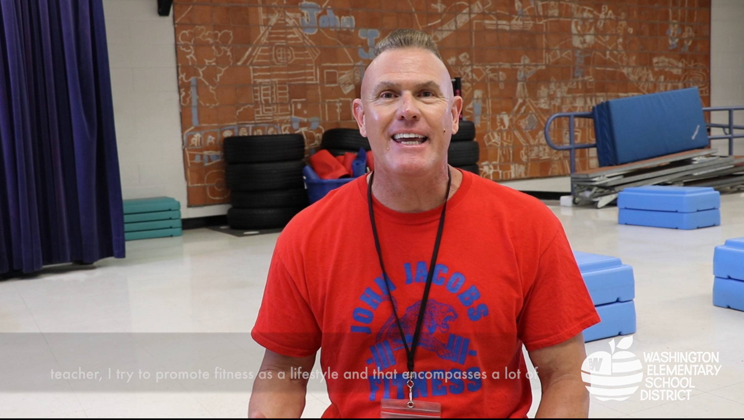
#WESDExcellence
Providing high quality educational experiences for all learners!

Slide 4
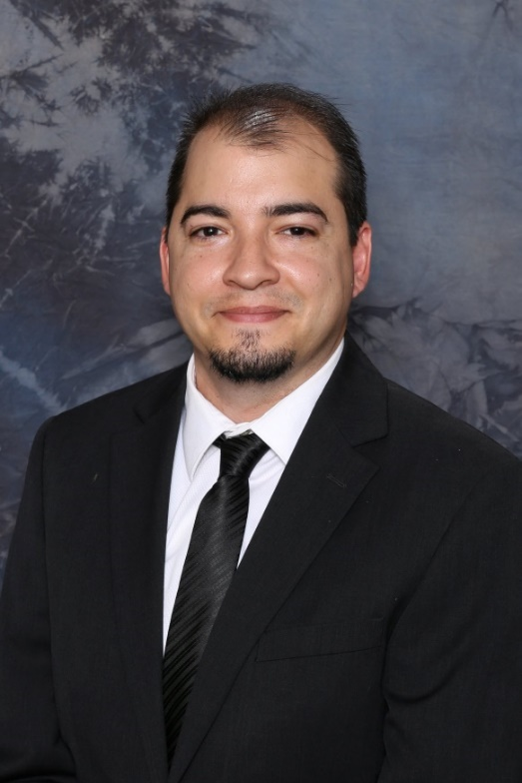
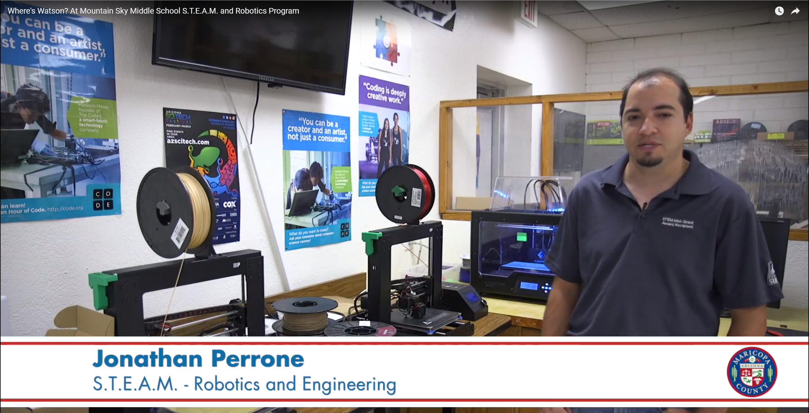
Teacher of the Year Finalist
One of five Ambassadors of Excellence
Winner Announced October 25
Jonathan Perrone
Mountain Sky Junior High
8th Grade STEM Teacher

Slide 5
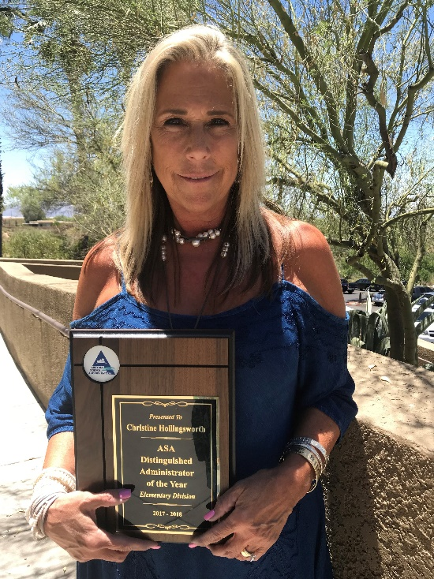
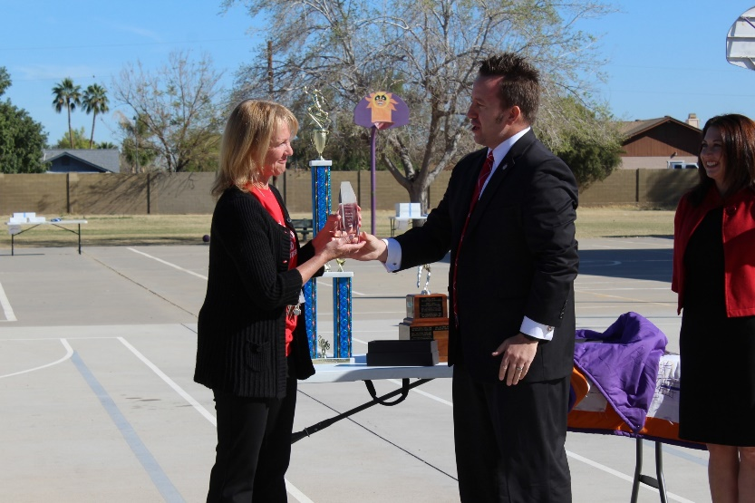
Award-winning Principals
Acacia Elementary
Christine Hollingsworth
2018 Distinguished Administrator
Arizona School Administrators
Sunburst Elementary
Rhonda Warren
2018 Exemplary Principal
Maricopa County Education Service Agency

Slide 6
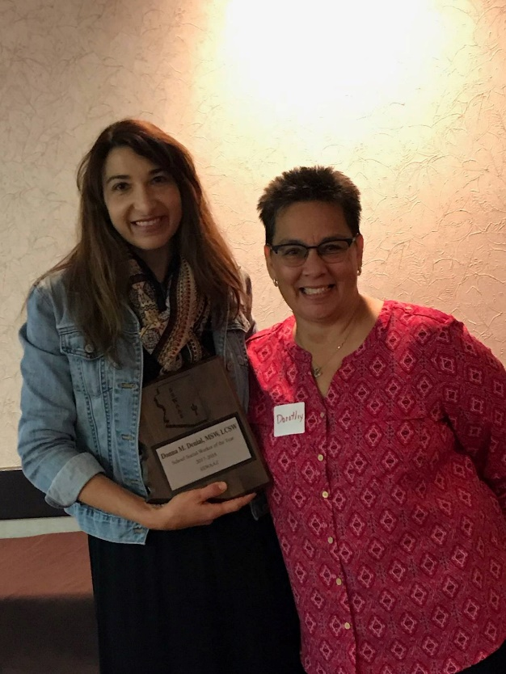
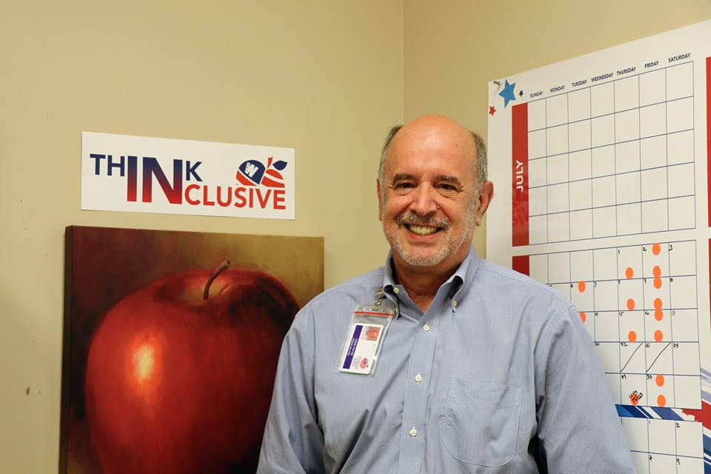
Award-winning Employees
Special Services
Dr. Craig Carter
2018 Outstanding Educator
Phoenix Mayor’s Commission on Disability Issues
Sunset Elementary
Donna Denial
2017 Social Worker of the Year

Slide 7


Award-winning schools
Acacia Elementary
Three-time A+ School
Arizona Educational Foundation
Silver - Ocotillo
Bronze - Acacia, Manzanita, Sahuaro and Sunnsylope
Merit – Chaparral and Mountain View

Slide 8
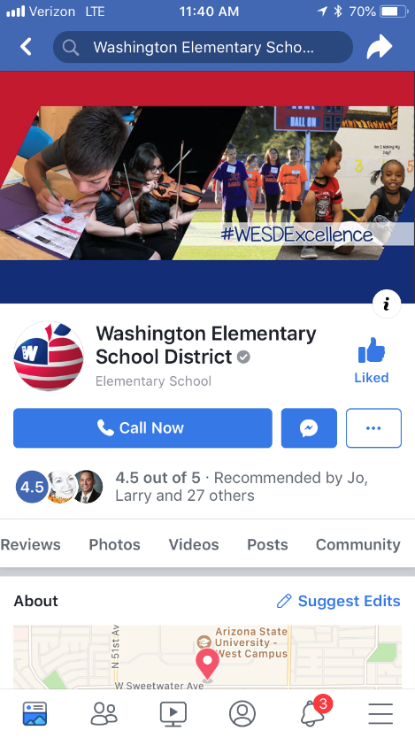
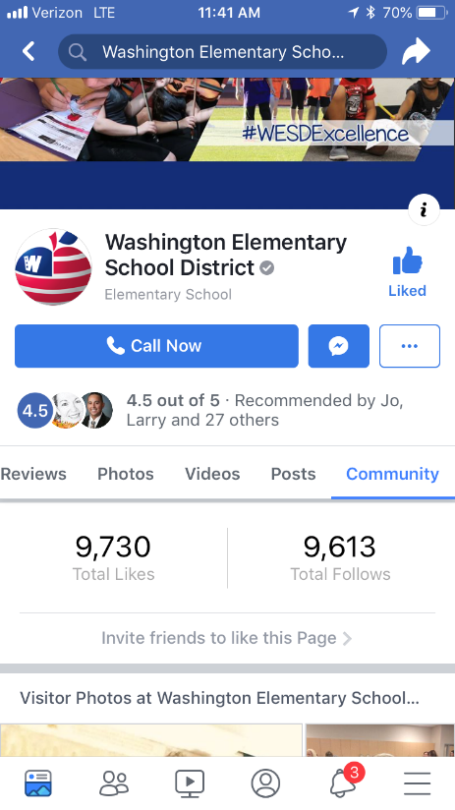
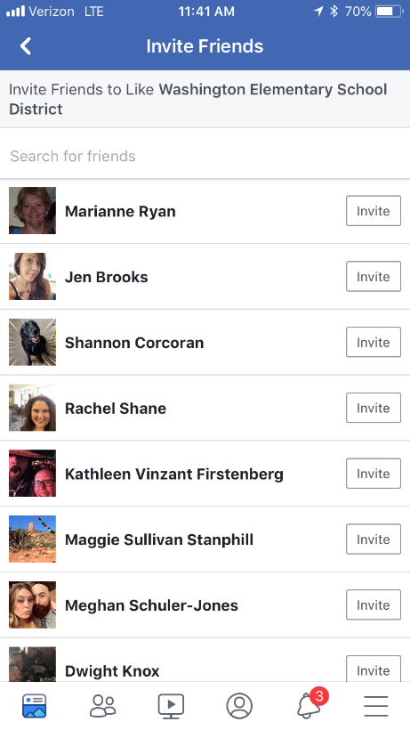

@WESDSchools
Follow and Like Us!
1.
2.
3.

Slide 9
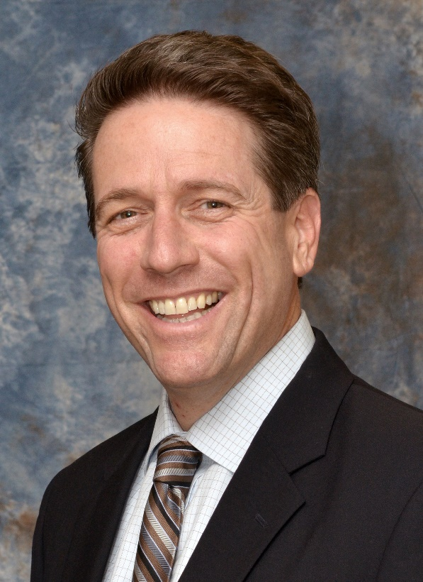
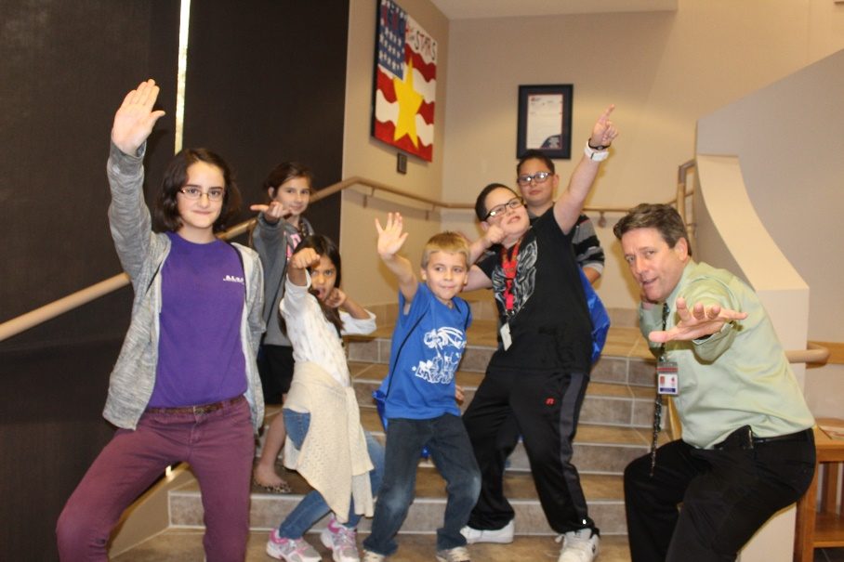
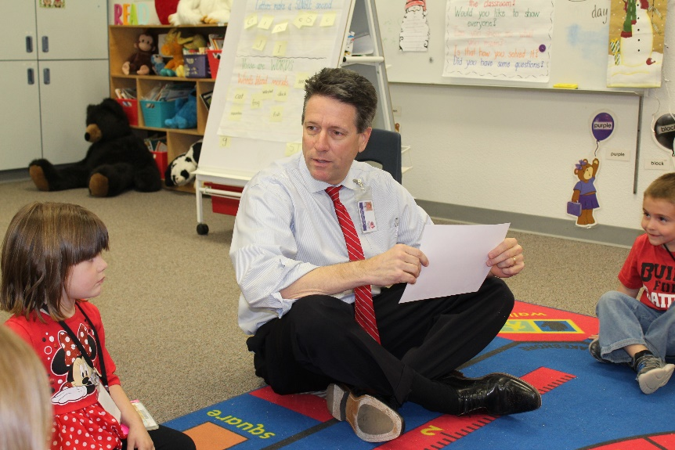
What’s Happening in WESD
Dr. Paul Stanton
Superintendent

Slide 10
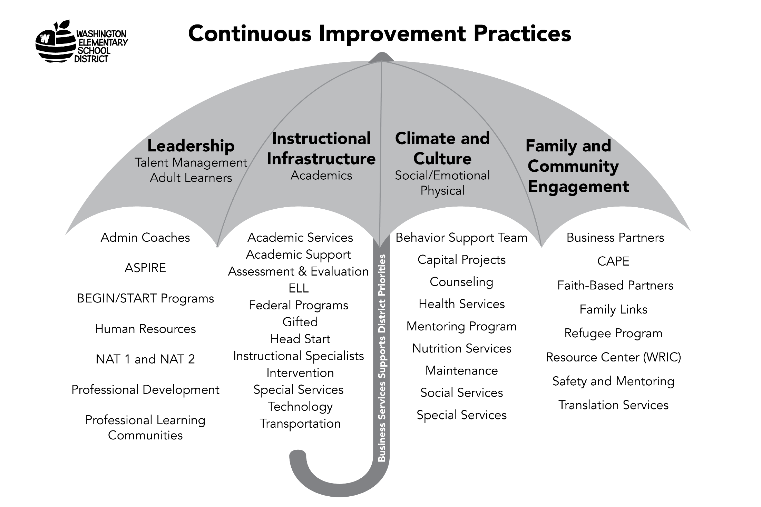

Slide 11
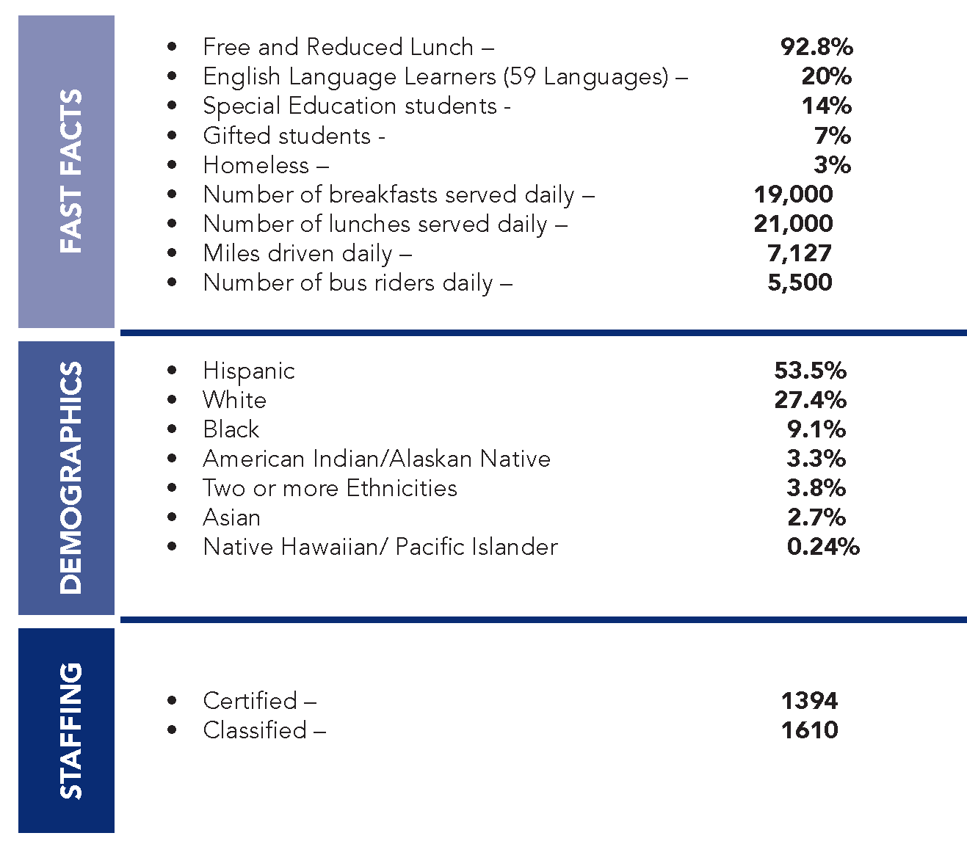
WESD at a Glance -
32 Schools Grades pre-K - 8
23,700 Students

Slide 12
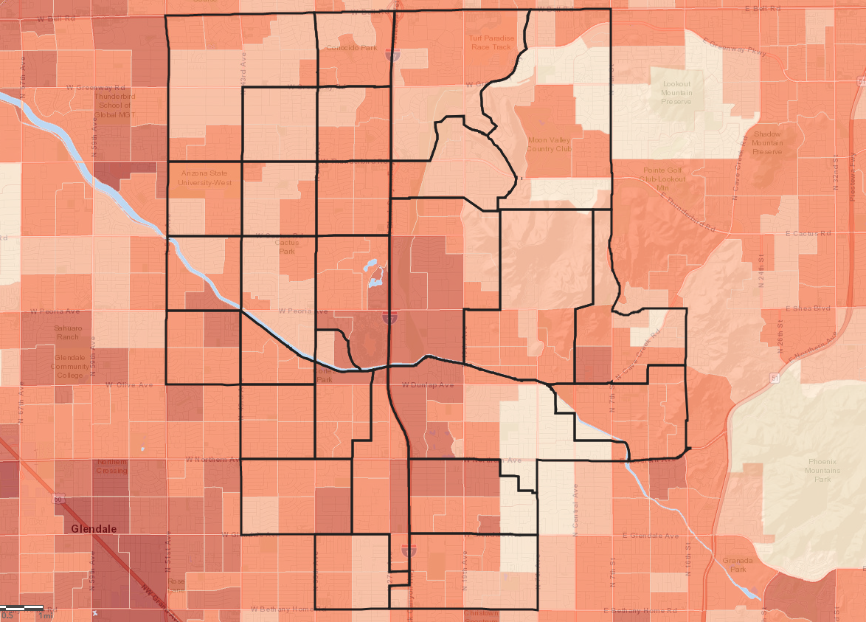
Factors that Impact Our Students
Crime Rates

Slide 13
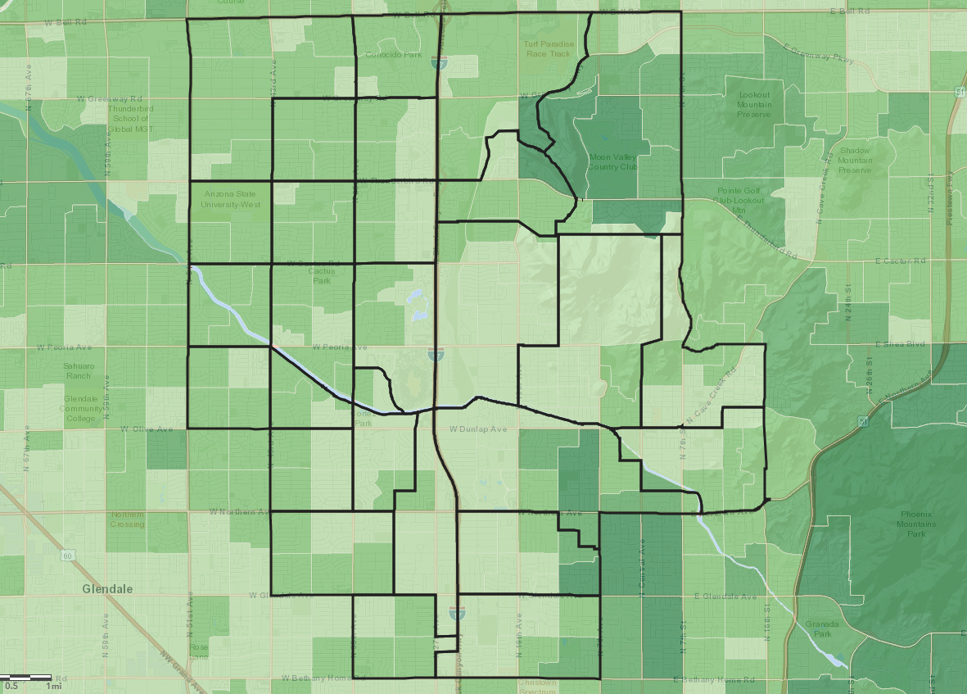
Factors that Impact Our Students
Average Household Income

Slide 14
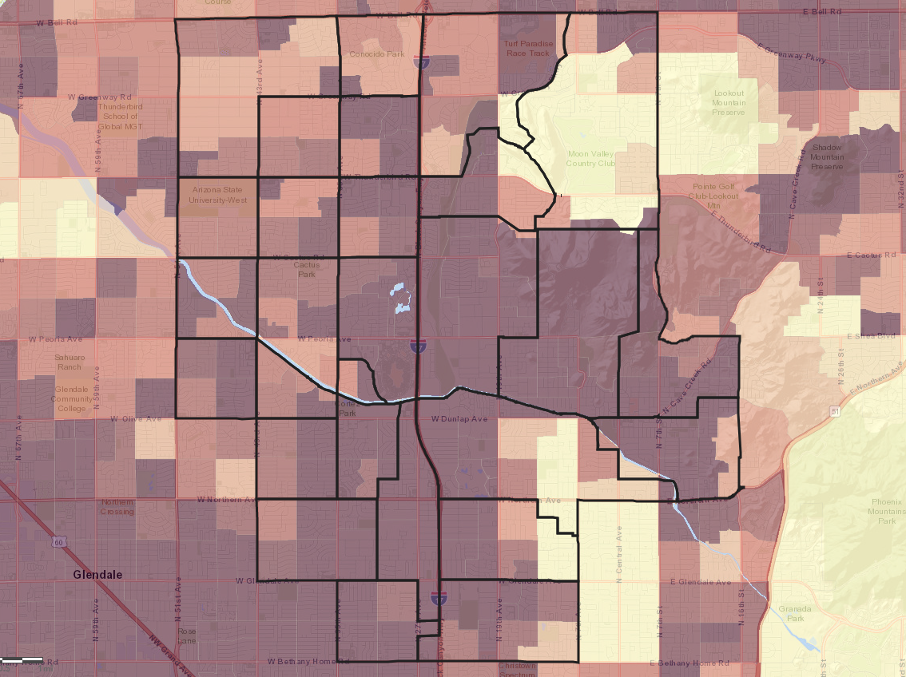
Factors that Impact Our Students
Emergency Expense Risk Index

Slide 15
Budget
This is the second year that the WESD has experienced a loss of students; this year we’re down more than 400.
Most students are physically moving to another area for many different reasons.
Since budget is based on student count, the annual budget will be reduced and limit options for the District.

Slide 16
Override Facts
WESD called for an election on November 6 to request continuation of an existing M&O override
An override allows the district to exceed budget limits for specific educational purposes
In WESD the current override helps to pay for
  Full-day Kindergarten
  Enhanced programs for art, music, PE, gifted
  Comprehensive services for students who require focused intervention to succeed
Tax rate is similar to current, and has been in place for several years
If the override isn’t approved, the district will have to decrease the operational budget over 3 years until phased out

Slide 17

Climate and Culture
Family and Community Engagement
WESD FACE Vision
  WESD Family and Community Engagement (FACE) honors and empowers families, students, teachers, staff and community partners to create collaborative relationships that support student success.

Slide 18
Climate and Culture
A Systems Approach
Evidence-based systems and practices support the physical and emotional well-being of students and staff
A Healthy Environment
Provide an environment in which students can practice what they learn about making safe, healthy decisions and staff can practice and model safe, healthy behaviors
Data
Use appropriate data to continuously improve

Slide 19
Behavioral and Emotional Social Support
District Climate Culture Team
Climate Culture/Athletic Director
Behavior Support Advocates
Transportation Behavior Support Advocate
Board Certified Behavior Analysts
Crisis Prevention Institute Trainings (CPI)
Safety and Mentoring Team
Child Study Process (CST)
Community Partnership Mentoring

Slide 20
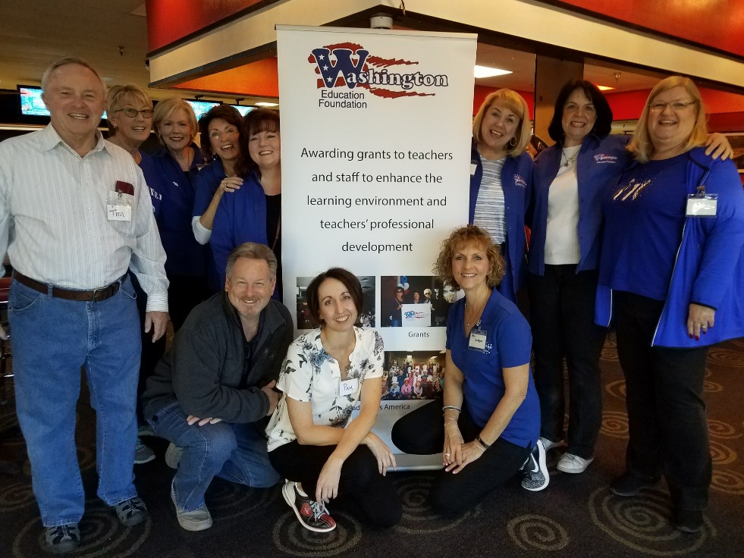
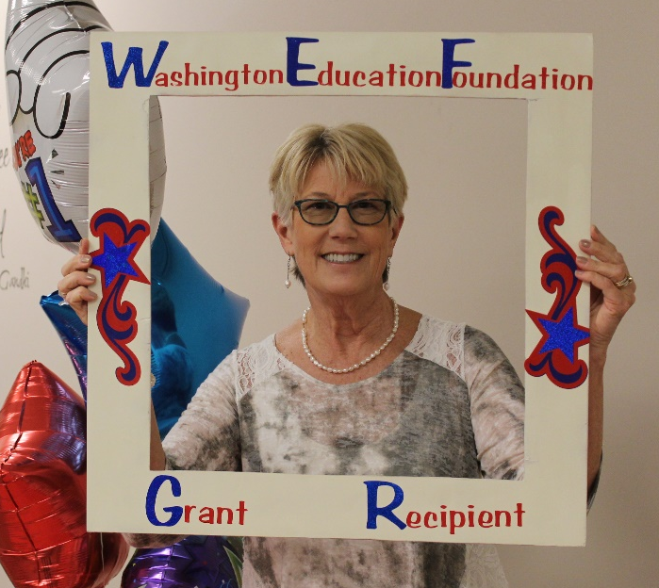
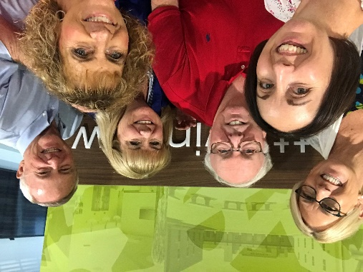

Washington Education Foundation

Slide 21

Speed Networking

Slide 22
Speed Networking
Introduce yourself to someone who works in a similar field as you (business, nonprofit, faith, government, education, etc.)
Find someone who has been to at least two BAT meetings.
Find someone who has school-age children (K-12).
Introduce yourself to someone wearing a WESD ID.
Find someone who loves partnering with the WESD!

Slide 23
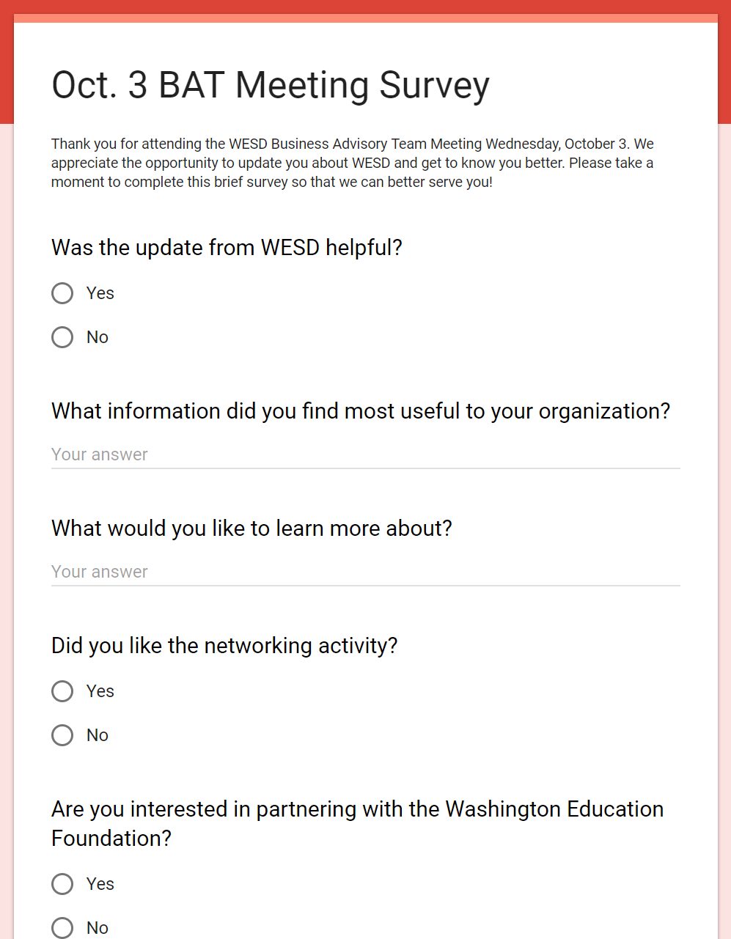
We Want to Hear from You!

Slide 24
Thank You!

